Slide 1
Connect 4 AI Bot
Onur Çopur
Dilara Işıklı
Chunhui Wu

Slide 2
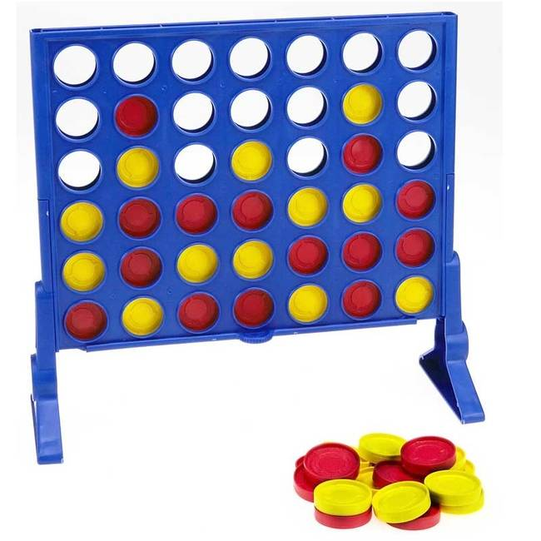
Algorithm steps
Wining condition check
Evaluation Function and decision tree
Iterative deepening and Horizon

Slide 3
Wining condition check
At each sate of the game board, check for if there is a wining condition
If the algorithms finds a wining situation (3 tokens in a row vertical, Horizontal, diagonal 1 or diagonal 2) and if there is a possible move to complete the game
Do not search for any other conditions on the decision tree.

Slide 4
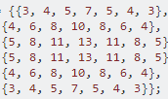
Evaluation Function and decision tree
First assign points to each cell on the game board. The numbers in the table indicate the number of four connected positions which include that space.
the 3 in the upper left corner is for one each of horizontal, vertical, and diagonal lines of four which can be made with it.
the 4 beside it is for two horizontal (one including starting in the corner, one starting on it, one vertical, and one diagonal)

Slide 5
After Creating the Score Board, we can start scoring.
Player 1 (Maximizing) starts with 138 points (total points on the score board divided by 2)
Player 2 (Minimizing) starts with -138 points

Slide 6
Lets say Player 1 makes the first move with the 1 st column. Then Player 2 will get a penalty with the score of player 1’s move.
So in this case the new score of player 2 would be -138 + 3 =-135
After if Player 2 makes a move for the second column, then Player 1 will get a penalty of 4 and the new score of player 1 would be 138 – 4 =134 and so on...

Slide 7
By this way, we can form the decision tree and the AI will make moves to maximize the final score of the Player 1.
After this point, we will concentrate on optimizing the decision tree search.

Slide 8
Iterative deepening and Horizon
Iterative deepening means that we limit the search time to some fixed amount and then we evaluate the nodes in the search tree.
We start evaluating with a horizon or look ahead of one move, then we look ahead for two moves, then three, etc.
Whenever we hit the time limit we continue the search with the current look ahead value, but stop afterwards.
This makes the AI “thinking” time more or less constant and the look ahead variable, but dependent on the (remaining) size of the tree.
This way we avoid that the AI is very slow for the first moves (when the search tree is still large) and very fast at the end (when there are not many possible moves left).

Slide 9
Horizon
Horizon is basically the level of deepness for the decision tree search.
In this project, we used a 4 step of horizon.

Slide 10
References
https://www.leaseweb.com/labs/2014/01/python-connect4-ai-mtdf-algorithm/
https://stackoverflow.com/questions/10985000/how-should-i-design-a-good-evaluation-function-for-connect-4
https://codereview.stackexchange.com/questions/82647/evaluation-function-for-connect-four
https://softwareengineering.stackexchange.com/questions/263514/why-does-this-evaluation-function-work-in-a-connect-four-game-in-java

Slide 11
Thank you For Listening

